Slide 1
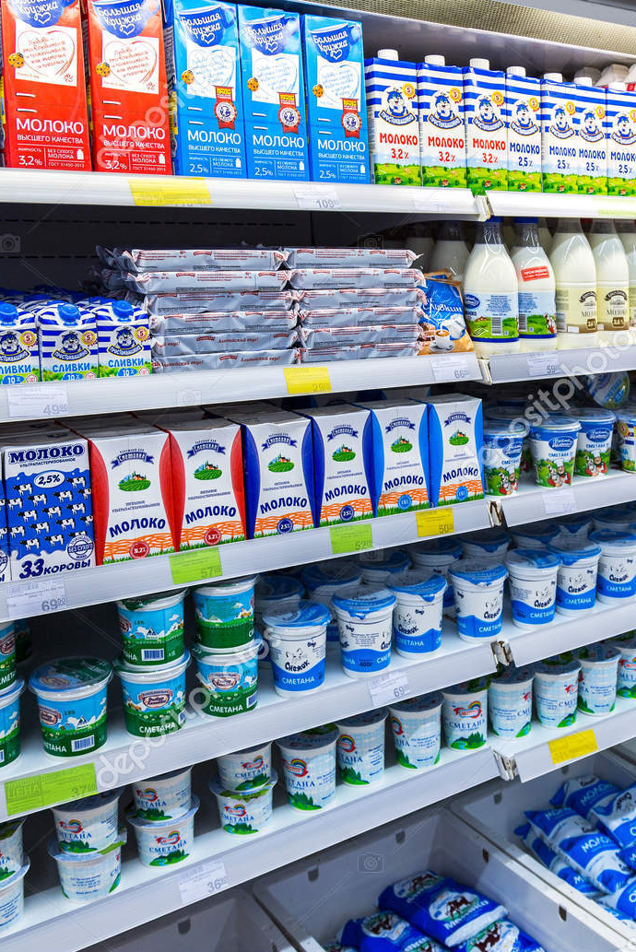

Supermarket A Dairy Product Cost Efficiency
A
Jakarta, October 2024

Slide 2
Problem Background
A
Initiation for Cost Efficiency
Shopping channel not only focused on conventional (i.e., brick and mortar) store, therefore some of on-site inventory need to be minimized.
Average
64%
of cost in every supermarket are generated from electricity for storing frozen and perishable goods.
Online Chanel Go-Live
Do mean that all goods ordered by customers will be delivered directly from the nearest warehouse in every state.
Logistic Division has provided a dataset. Containing information for Dairy Product together with its supplier and farm origin.

Slide 3
Problem Statement
A
S
M
A
R
T
Increase the profit of Supermarket A through cost reduction
10% inventory costs reduction
Eliminate slow-moved products
Detecting low inventory turnover ratio product
Achievable in
1st Quarter
Objective Breakdown
1
Describe average monthly cost of dairy product, find pattern to be summarized
Comparing average product cost and average products revenue, find the least performed product
Calculate Turnover Ratio for each products, and indicate low-performed product
For those low-performed, analyzing the correlation with its supplier
Finds out if lower turnover ratio caused by high selling price or not
Analyze the relation of those product with farm origin and supplier
2
3
4
5
6

Slide 4
Data
A
Dataset Overview : data containing information of dairy products (milk, cheese, yogurt, and butter) supply chain, containing 15 cols and 1811 rows.
Dairy Product Inventory Data 2022 -2023
Dimension:
1811 rows
10 columns
Data Cleaning Process
+8Col
[‘farm_city’],[‘farm_state’],
[‘year’], [‘month’], [‘day’], [‘turnover_ratio], [‘storage_cost’], [‘revenue’]
3/18
columns are dropped
[‘category’], [‘product_id’], [‘farm_location’]
[‘product_id’],
[‘product_name’],
[‘category’],
[‘price_per_kg’],
[‘units_shipped_kg’],
[‘units_sold_kg’],
[‘units_on_hand_kg’],
[‘supplier’],
[‘farm_location’],
[‘sale_date’]

Slide 5
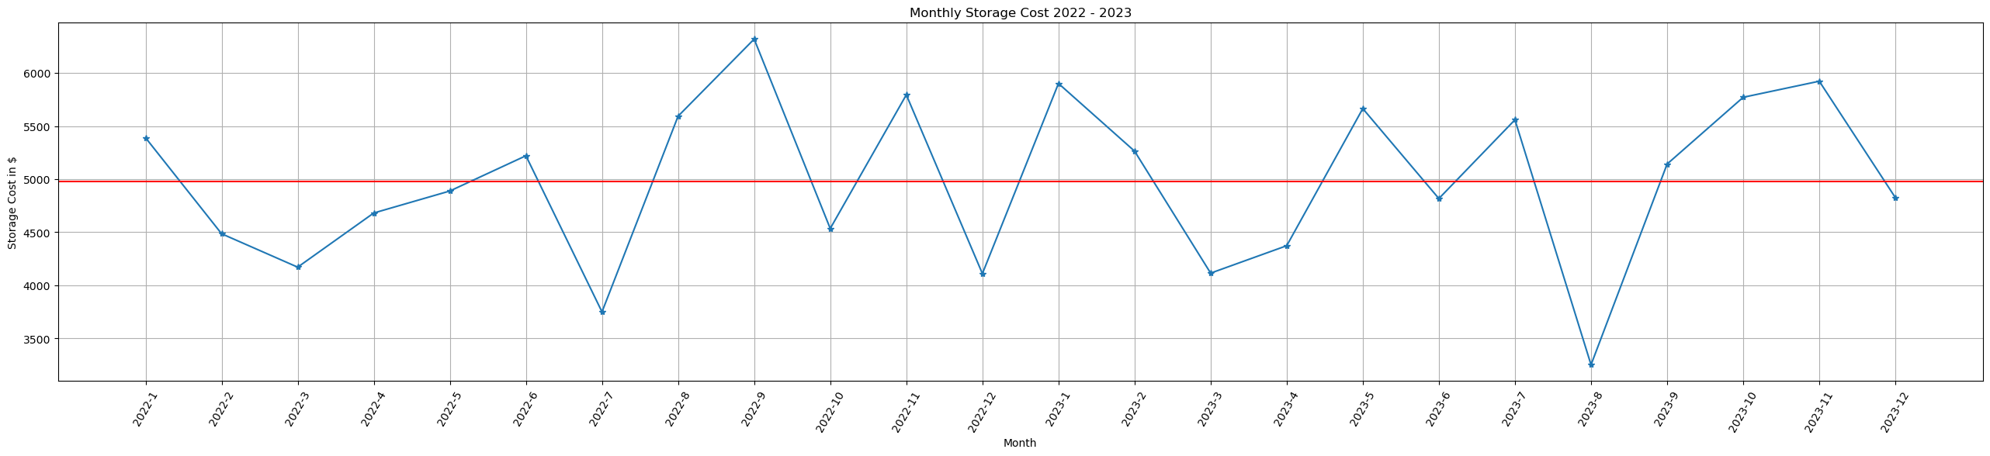
Analysis
A
Average Monthly Cost for Dairy Product 2022 - 2023
Average of monthly cost for dairy product
$ 4980.97
Findings in period of 2022 and 2023:
12 months over the average
12 months under the average
No specific pattern can be described
Therefore, observes cost and revenue comparation be necessary
Notes:
Dalam rentang dua tahun, terdapat 11 storage cost yang berada diatas rata-rata, tetapi belum ada kesimpulan spesifik yang bisa ditarik. Selain itu, line chart diatas menandakan bahwa persebaran antara rata-rata bulanan yang diatas total avarege dengan yang dibawah average berjumlah sama (12 bulan di atas avg dan 12 bulan di bawah avg) sehingga tidak tergambarkan pola tertentu. Analisa akan dilanjutkan dengan memperhitungkan cost dan revenue dari masing-masing kategori produk.

Slide 6
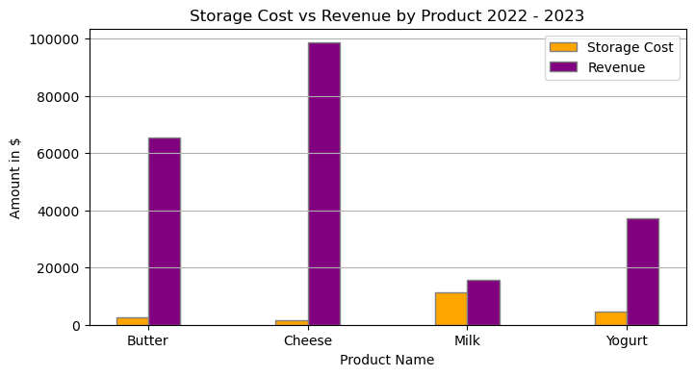
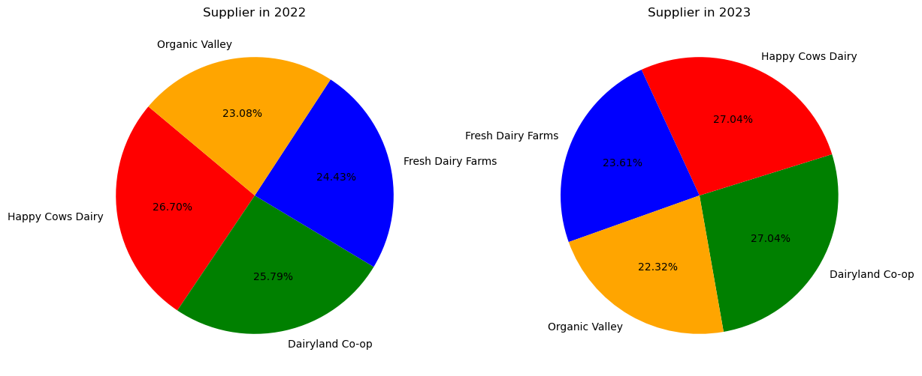
Analysis
15600.93
A
Average Cost & Revenue by Product 2022 - 2023
Milk Product Percentage by Supplier
Milk contributes
$11294.42
of Inventory Cost
*avg. dairy product cost $ 4980.97
only generates
$15600.93
Revenue
Booth Milk, Yogurt, Butter and Cheese are only supplied by those 4 suppliers. Pie Chart indicate the supplier percentage for Milk only.
Notes:
Setelah mendapatkan gambaran umum dari kategori produk dairy, selanjutnya akan dilakukan analisa yang lebih spesifik, yaitu terhadap produk susu saja. Kalkulasi yang akan diberlakukan adalah turnover ratio, karena tidak ada produk pembanding selain susu nantinya. Sehingga kesimpulan dapat ditarik nantinya adalah dari tinggi atau rendahnya prosentase jumlah produk terjual melalui turnover ratio.

Slide 7
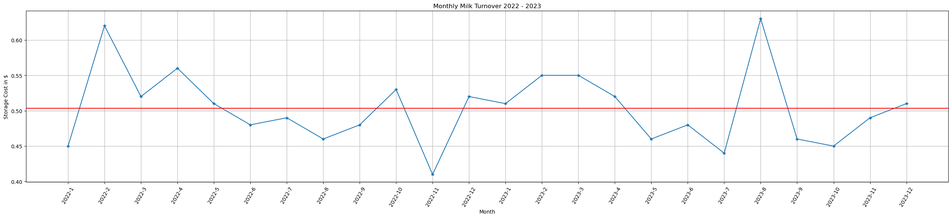
Analysis
A
Inventory Turnover Ratio
Why Turnover Ratio?
Specific analysis on Milk Product
Cost and Revenue analysis related to financial comparation while Turnover Ratio refers to efficiency
Avg. of Milk Turnover Ratio
0.5
Range of Milk Turnover Ratio
Min : 0.01
Max : 0.92
The line plot above indicates periods when the product underperformed in sales as well as when it performed well.
However, no seasonal pattern can be identified since the product can only be distinguished by its Supplier and Farm Origin.

Slide 8
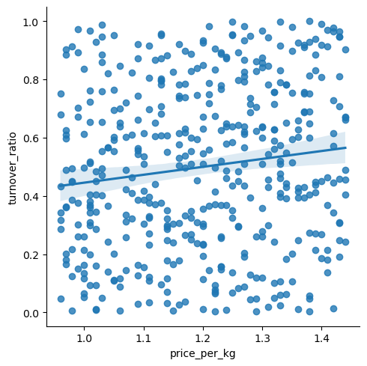
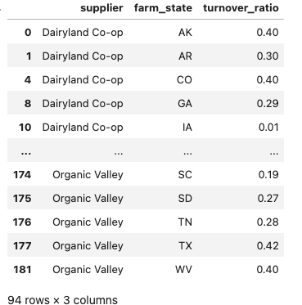
Analysis
A
Do Price and Turnover Ratio Influence Each Other?
Examined using Spearman
P-value 0.004
rho-correlation 0.13
It was found that 94 milk products from various suppliers and different farm origins have a turnover ratio of less than 0.5.

Slide 9
Conclusion
A
The average monthly storage cost for dairy products over two years is $4,980.97, with inconclusive sales trends due to fluctuations.
avg costs are:
$2,627.34 for Butter, $1,579.41 for Cheese,
$11,294.42 for Milk, and
$4,476.66 for Yogurt. Milk is the least profitable despite overall revenue exceeding costs.
The product with the least profitability is Milk, due to its disproportionate cost-to-revenue ratio.
Further Improvement
Compare before and after elimination of slow-moving milk products, hence the assumptions of cost efficiency can be described.
Analyze which supplier and which farm contributes to least moving Milk to ease management decision
Milk suppliers have an even distribution.
Higher prices do not correlate with slow sales, rather with quicker sales, though not significantly.
94 Milk products from various suppliers and farms show low potential, with turnover ratios below the dairy product average (0.5).

Slide 10
A
Thankyou ☺
Dashboard generated via Tableau Public can be accessed through:
https://public.tableau.com/shared/SGD8QNRPH?:display_count=n&:origin=viz_share_link

